Slide 1
Quick recap of Analytical Methods Exercises
Mass Spectrometry (MS), Infrared Spectroscopy (IR), and UV-VIS Spectroscopy

Slide 2
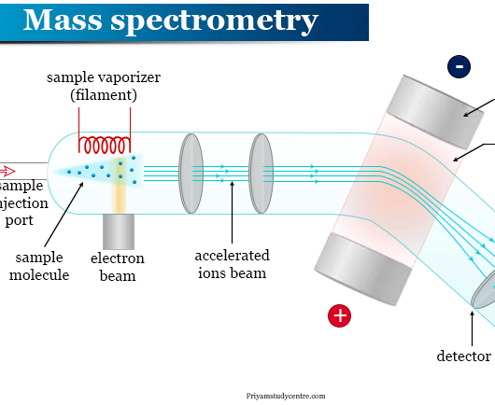
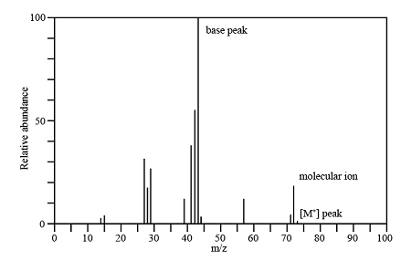
Mass Spectrometry (MS) - Overview
MS determines molecular weight and structure by ionizing molecules and measuring mass-to-charge ratios.
Identifies isotopes via mass spectra.
Helps determine molecular composition.
Used for unknown compound identification.

Slide 3
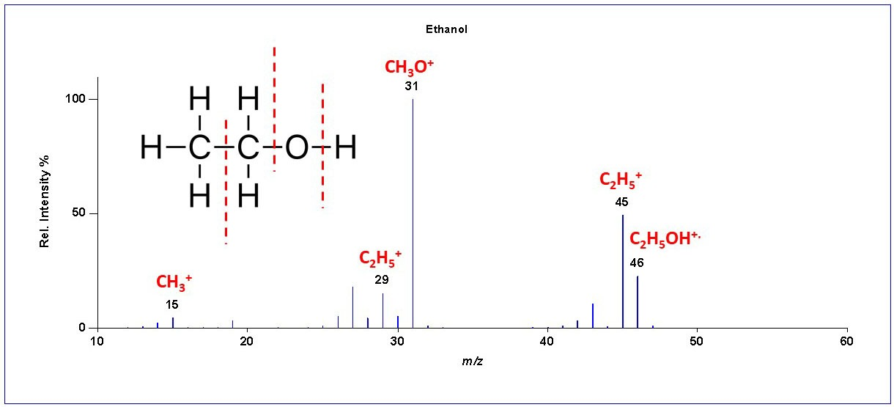
example

Slide 4
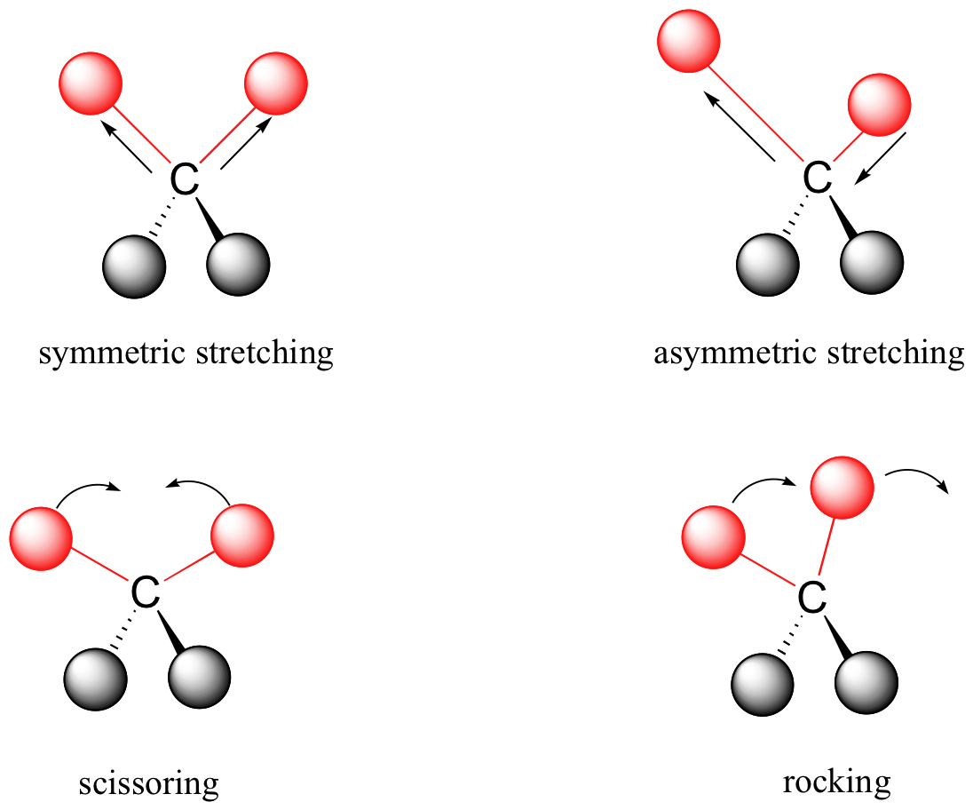
Infrared Spectroscopy (IR) - Overview
IR Spectroscopy identifies functional groups by analyzing molecular vibrations.
Different bonds absorb at characteristic frequencies.
Strong peaks help determine functional groups (e.g., OH, C=O, NH).

Slide 5
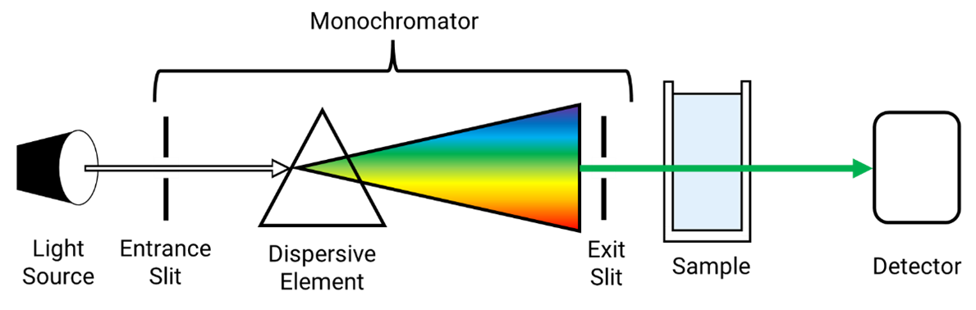
UV-VIS Spectroscopy - Overview
UV-VIS measures absorbance of light by molecules.
- Longer conjugated systems absorb at longer wavelengths.
- Useful for concentration determination (Beer-Lambert Law).
- Applied in DNA/protein studies, pharmaceuticals.

Slide 6
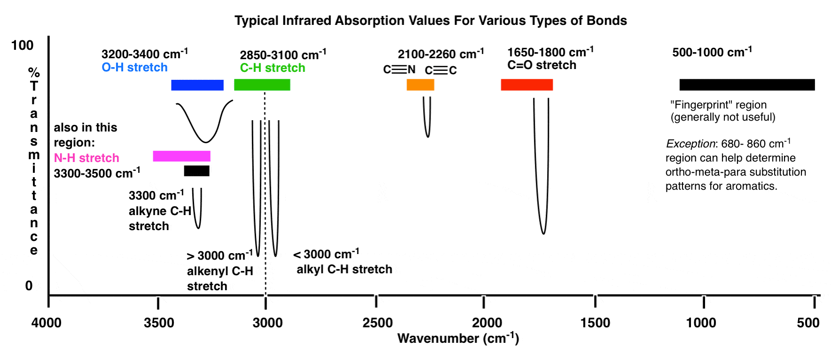
IR overview
IR Spectroscopy identifies functional groups by analyzing molecular vibrations.
- Different bonds absorb at characteristic frequencies.
- Strong peaks help determine functional groups (e.g., OH, C=O, NH).

Slide 7
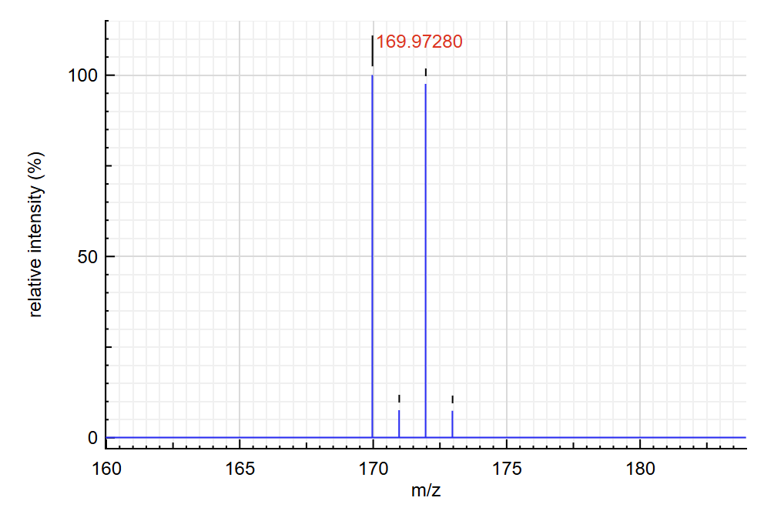
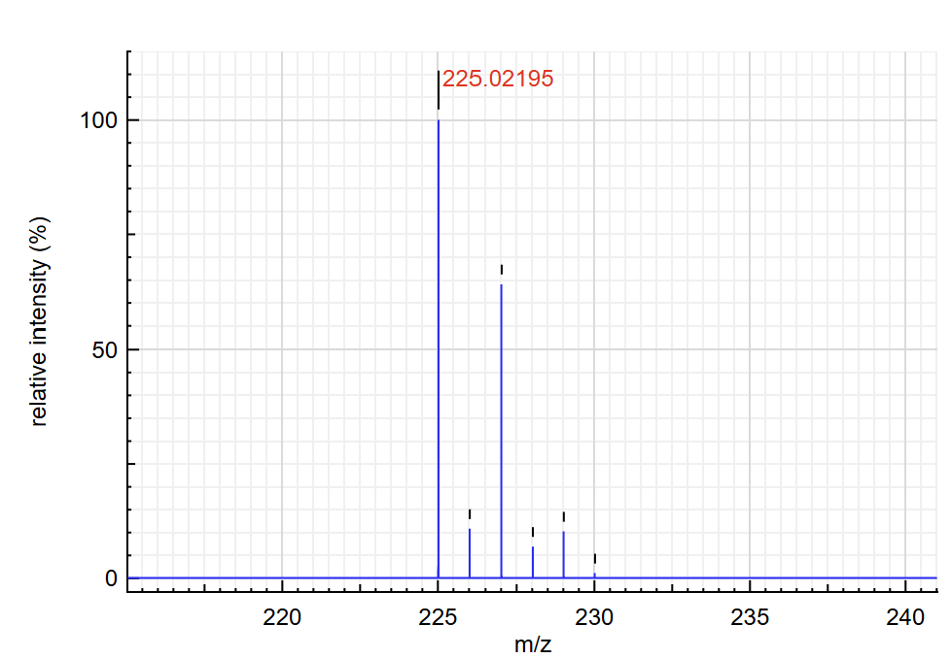
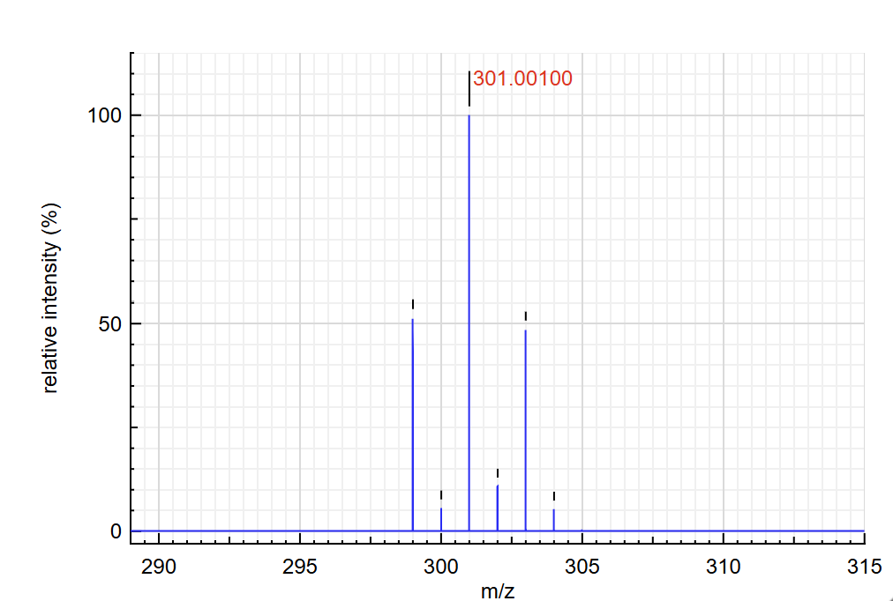
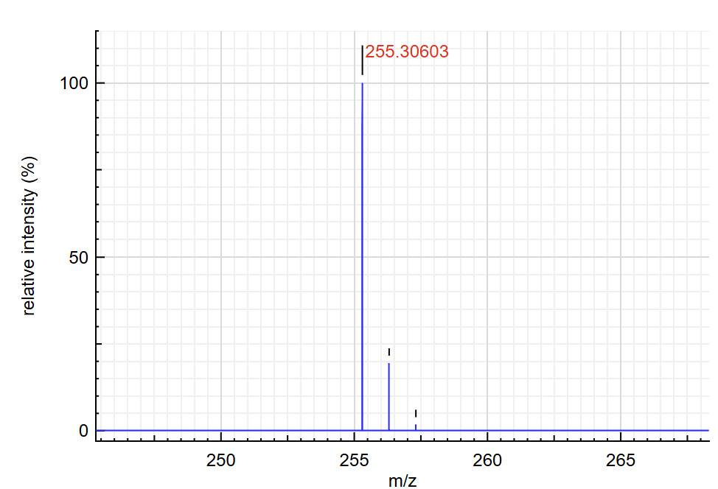
Exercise 3.1 - Mass Spectrometry (MS)
Match molecular formulas to MS spectra:
- C7H7Br: M+2 peak equal in size to molecular ion peak.
- C10H10Cl2: Identified using isotope distribution.
- C10H20Br2: Three peaks due to Br isotopes.
- C18H38: No M+2 peak, confirming absence of Cl or Br.

Slide 8
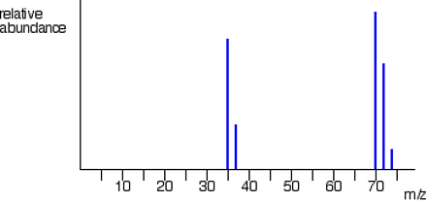
Exercise 3.2 - MS: Cl2 Spectrum Analysis
Cl2 spectrum shows three peaks at 70, 72, and 74 m/z due to different isotopic combinations.
- Monoisotopic peak: 70 m/z (35Cl-35Cl).

Slide 9
Exercise 3.3 - UV-VIS Concentration Calculation
Calculate the concentration of guanosine using Beer's Law:
A = εlc
Given: A = 0.70, ε = 8400 [1/M*cm], l = 1 cm.
Concentration (c) = 8.33 x 10^-5 mol/L

Slide 10
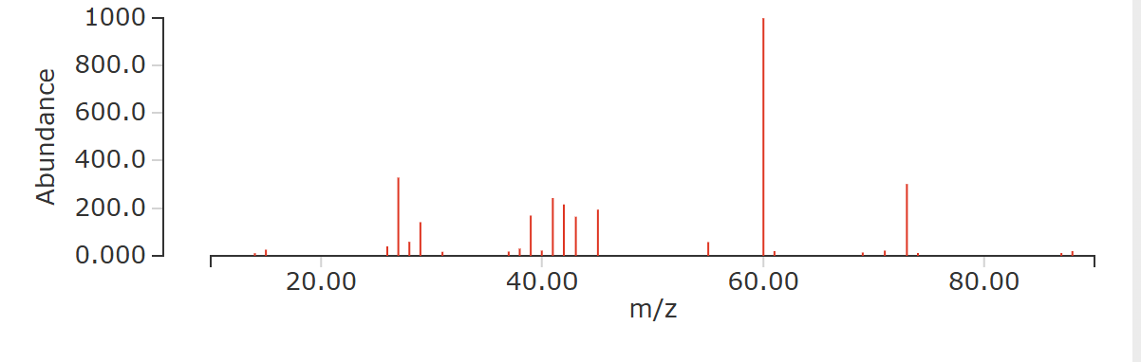
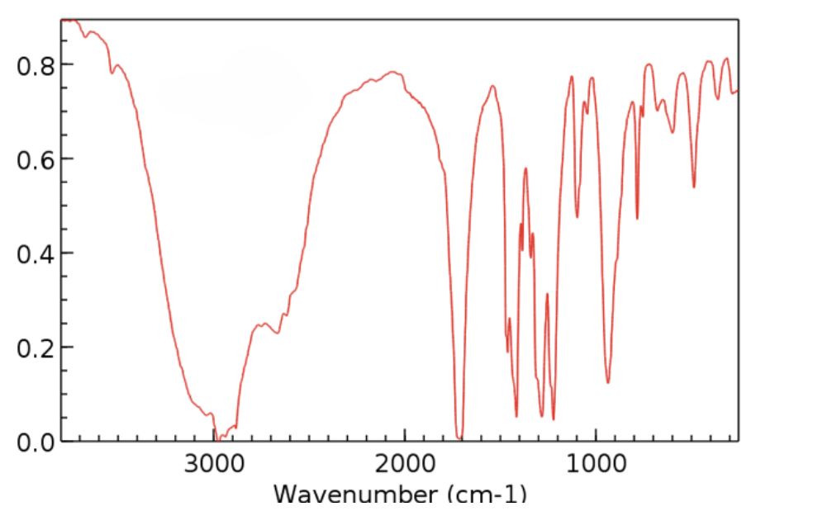
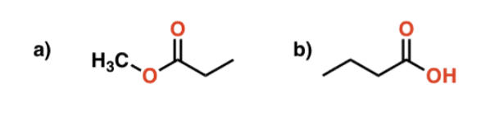
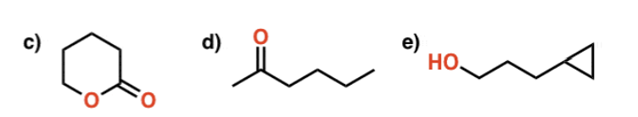
Exercise 3.4 - MS & IR Spectroscopy Identification
Identify unknown compound:
MS Spectrum: Molecular weight ~88 g/mol eliminates options (c), (d), (e).
IR Spectrum: Peak at 3300-2600 cm^-1 indicates OH group.
Answer: Butyric acid (b).

Slide 11
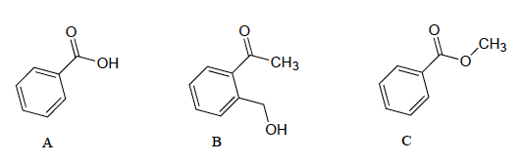
Exercise 3.5 - IR Spectroscopy: Functional Groups
A (Carboxylic Acid): Broad O-H (3000cm-1) peak, strong C=O peak.
B (Ketone): Strong C=O peak, alcohol O-H (3300cm-1) peak.
C (Ester): Shorter wavelength C=O peak, no broad O-H peak.

Slide 12
Exercise 3.6 - IR Spectroscopy Identification

Slide 13
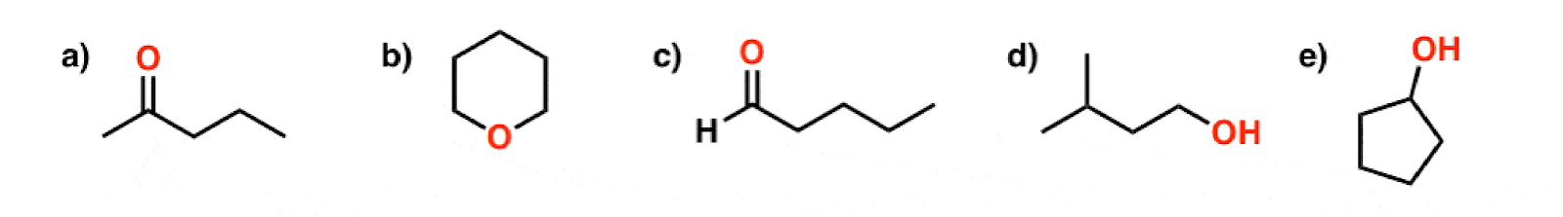
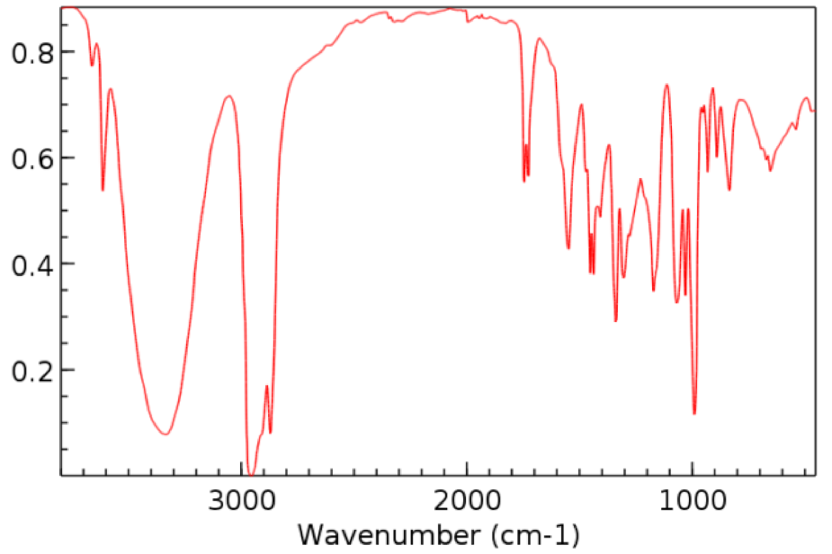

Slide 14
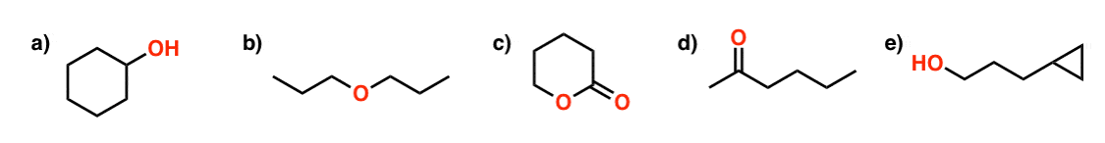
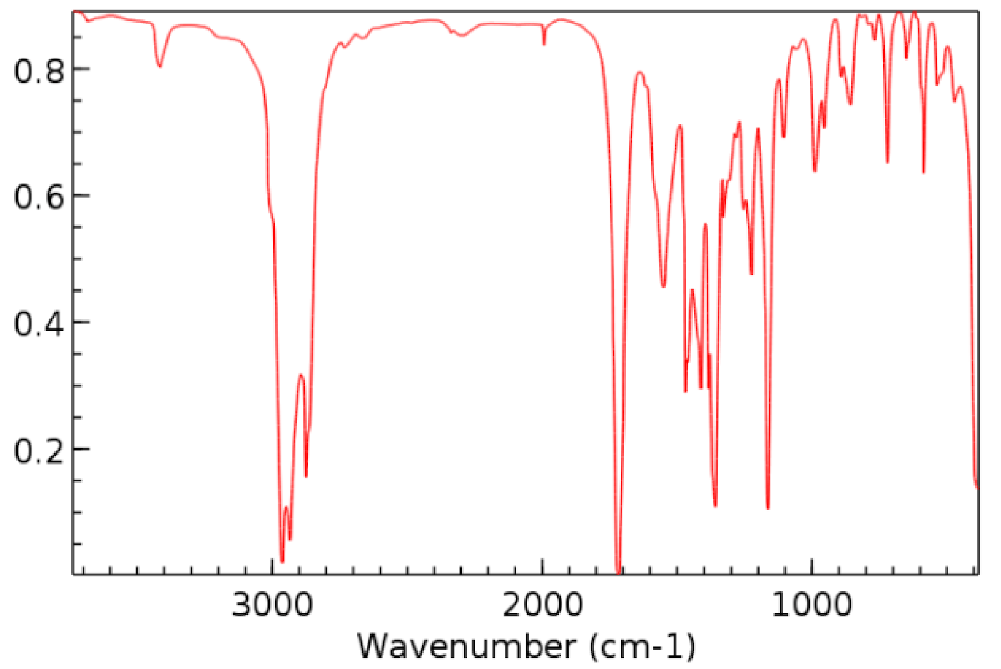

Slide 15
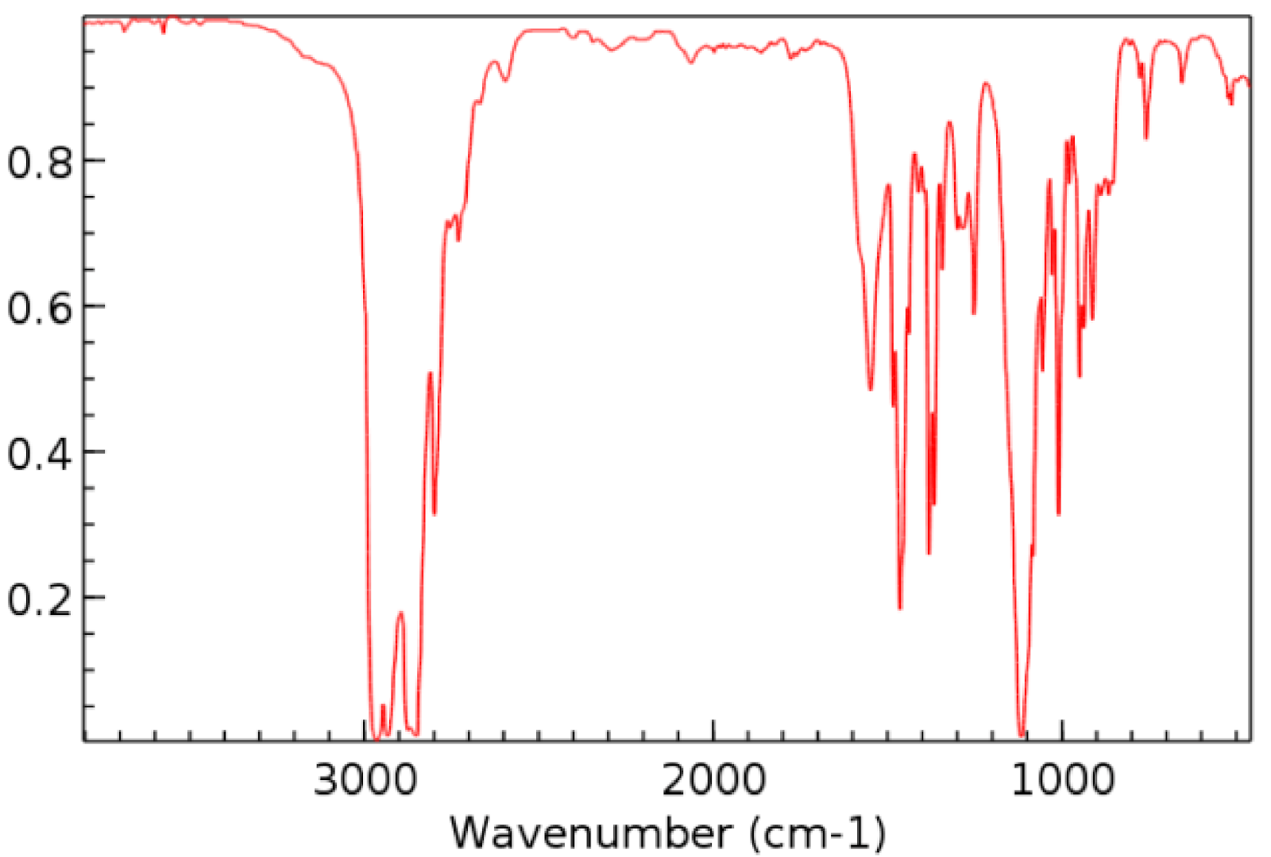

Slide 16
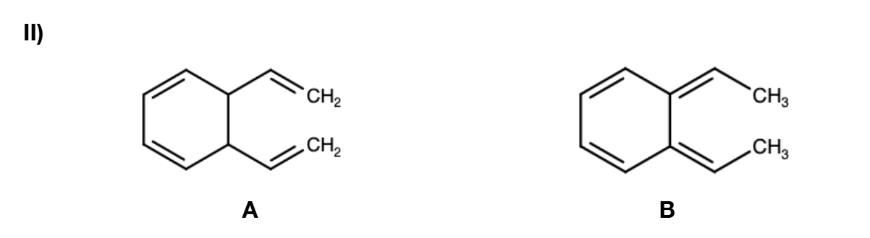
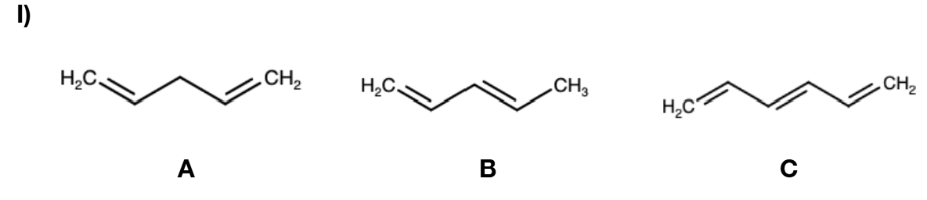
Exercise 3.7 - UV-VIS Absorption Trends
Compare absorption wavelengths:
(I) Order: C > B > A (longer conjugation absorbs longer wavelengths).
(II) Order: B > A (extended conjugation).

Slide 17
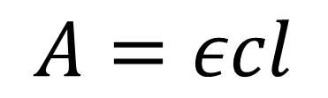
Exercise 3.8 - DNA Concentration Calculation
Calculate DNA concentration using Beer's Law:
Dilution factor = 10
Final concentration: 225 ng/μL.
$$A=εcl$$

Slide 18
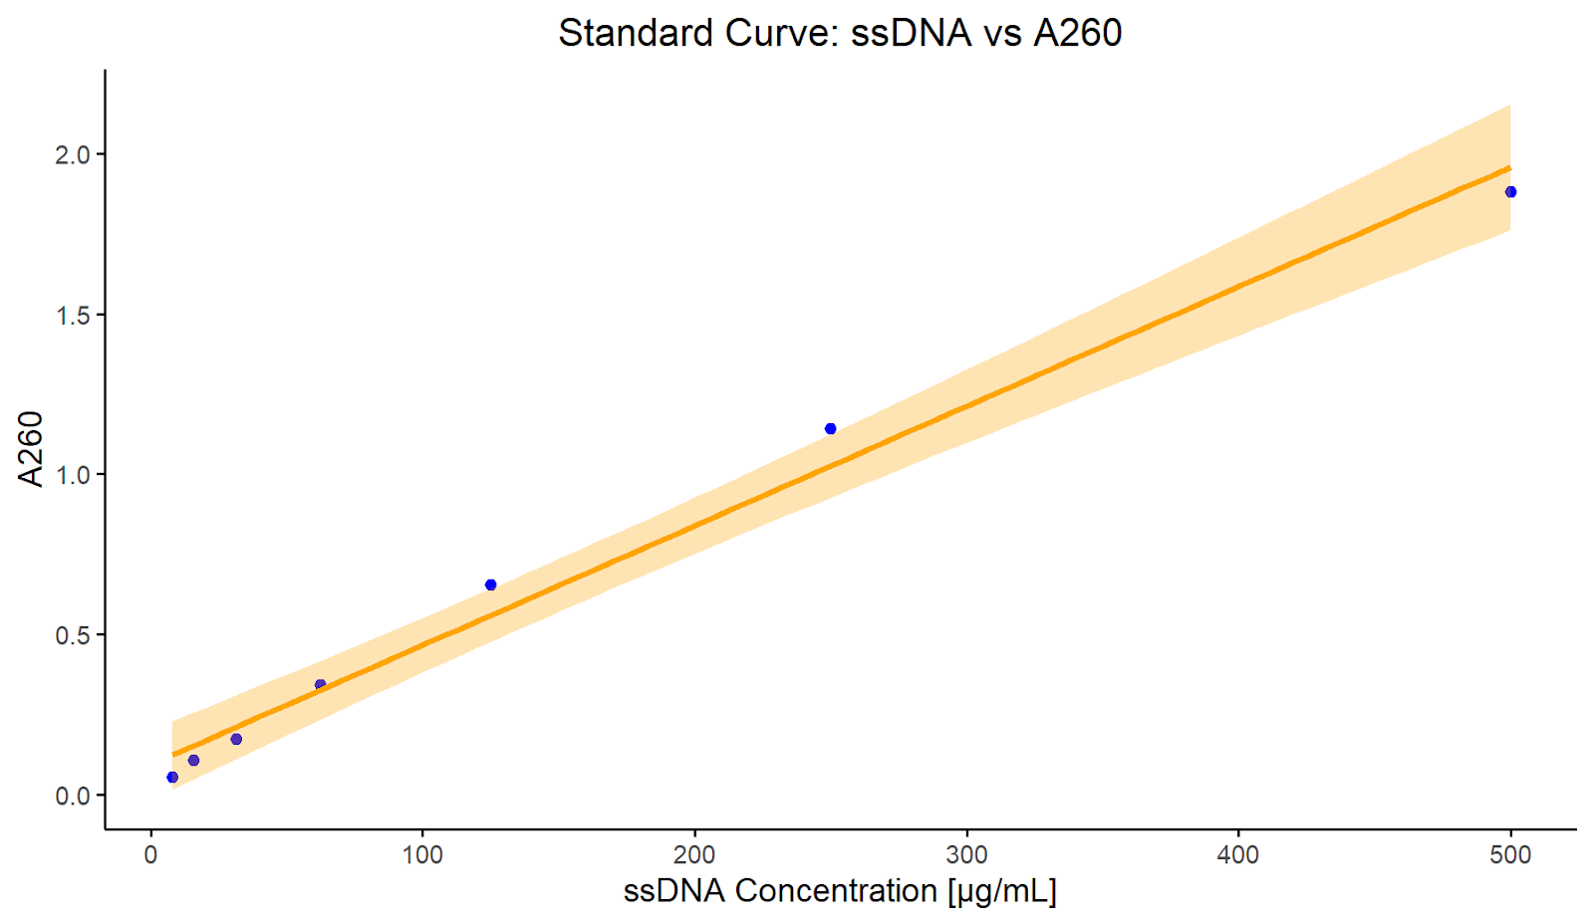
Exercise 3.9 - Calibration Curve & UV-VIS
Estimate DNA concentration using a calibration curve:
- A260 = 1.5 → Approx. 150 μg/mL.
- Extrapolating beyond the measured range is unreliable.

Slide 19

Questions?

